Slide 1
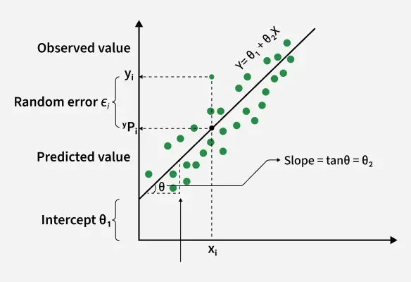
Simple Regression: Predicting Numbers
Drawing the Line of Best Fit into the Future
Instructor: Zaryab Ahmad Khan

Slide 2
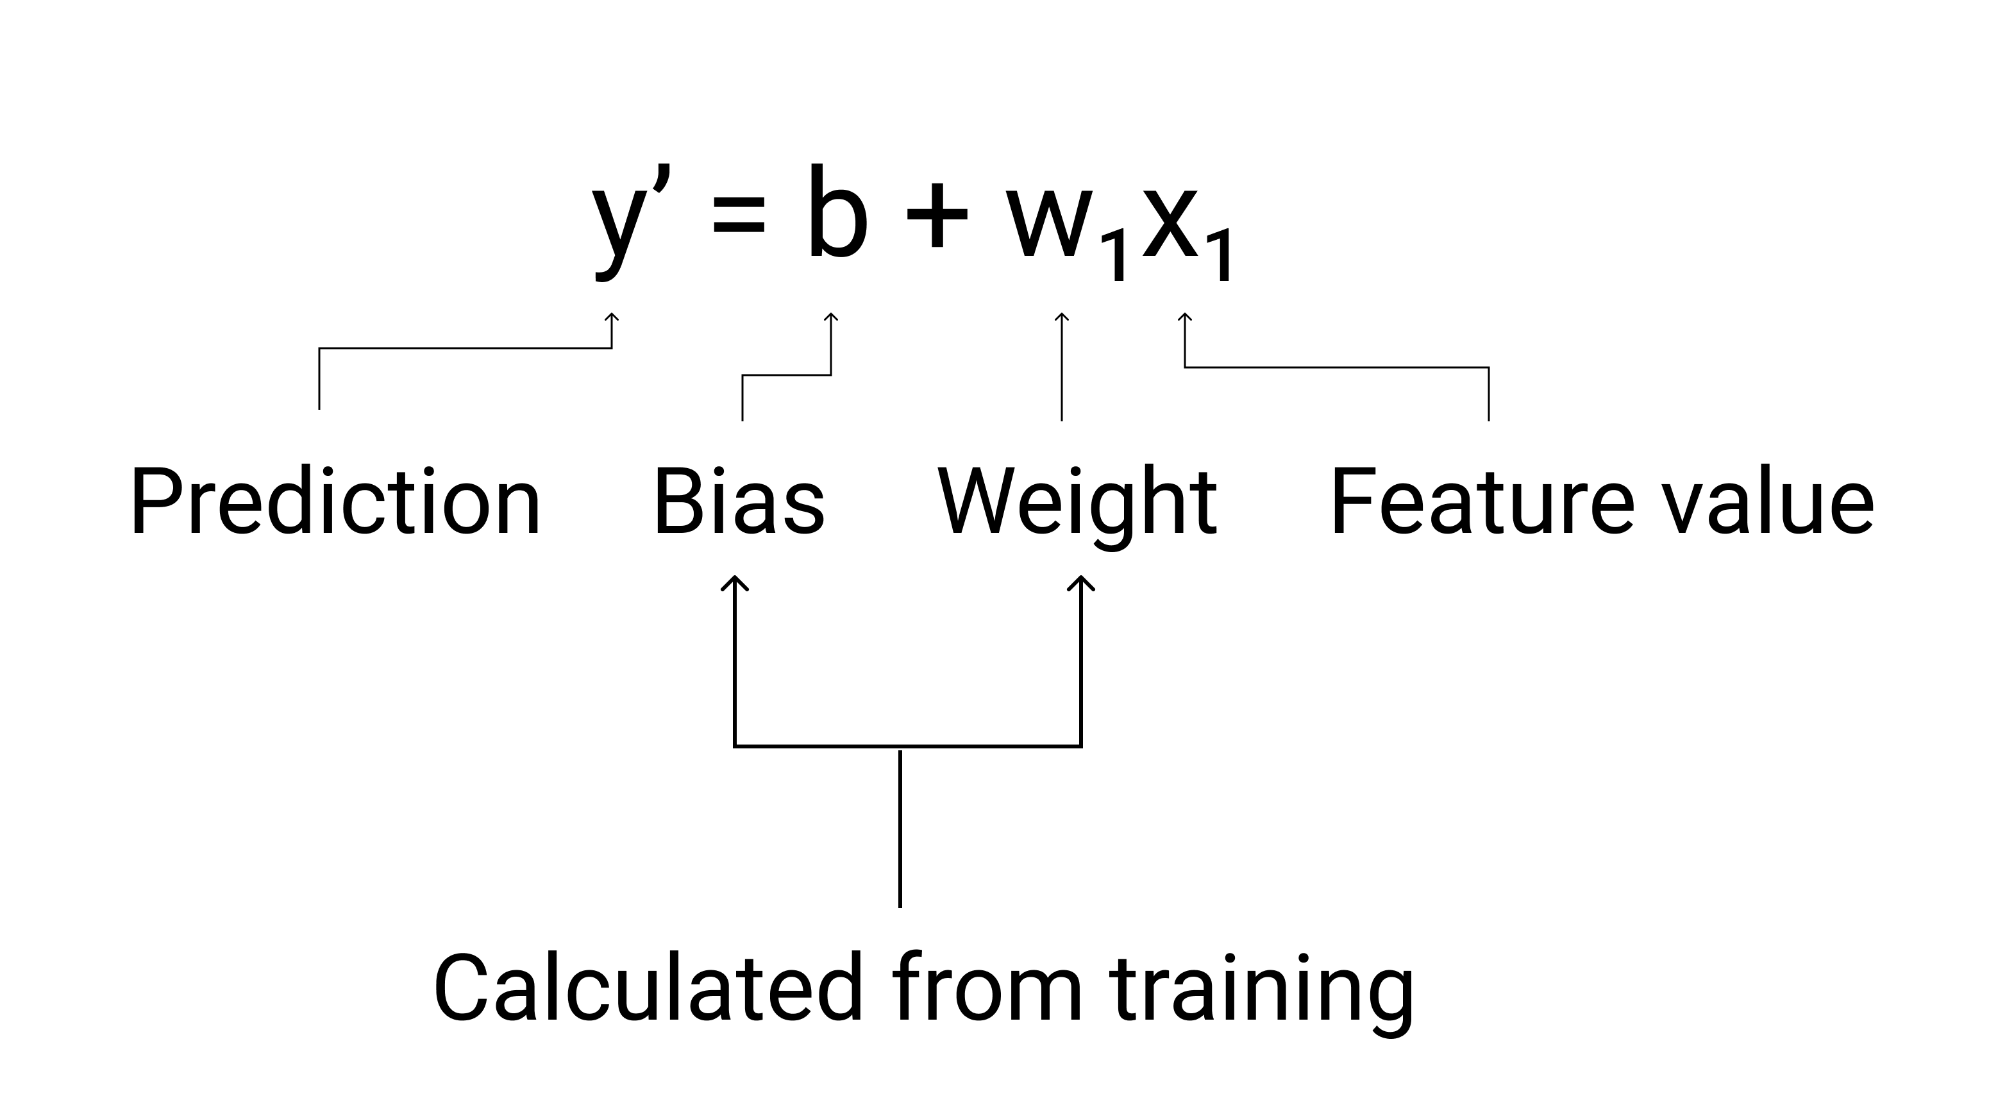
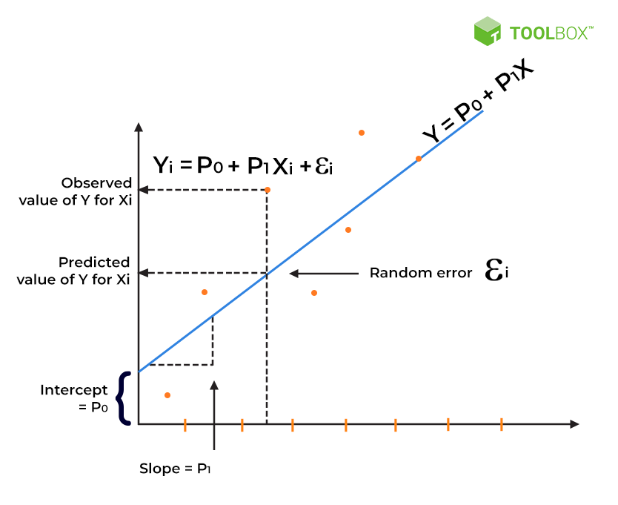
Simple Linear Regression (The Foundation)
Concept: Predicting an outcome using a single variable.
How it works: The algorithm draws the mathematical "Line of Best Fit" straight through your data points on a graph.
Real-World Use: Predicting crop yield based solely on the amount of rainfall.

Slide 3
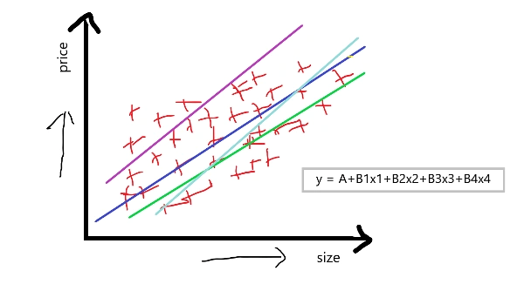
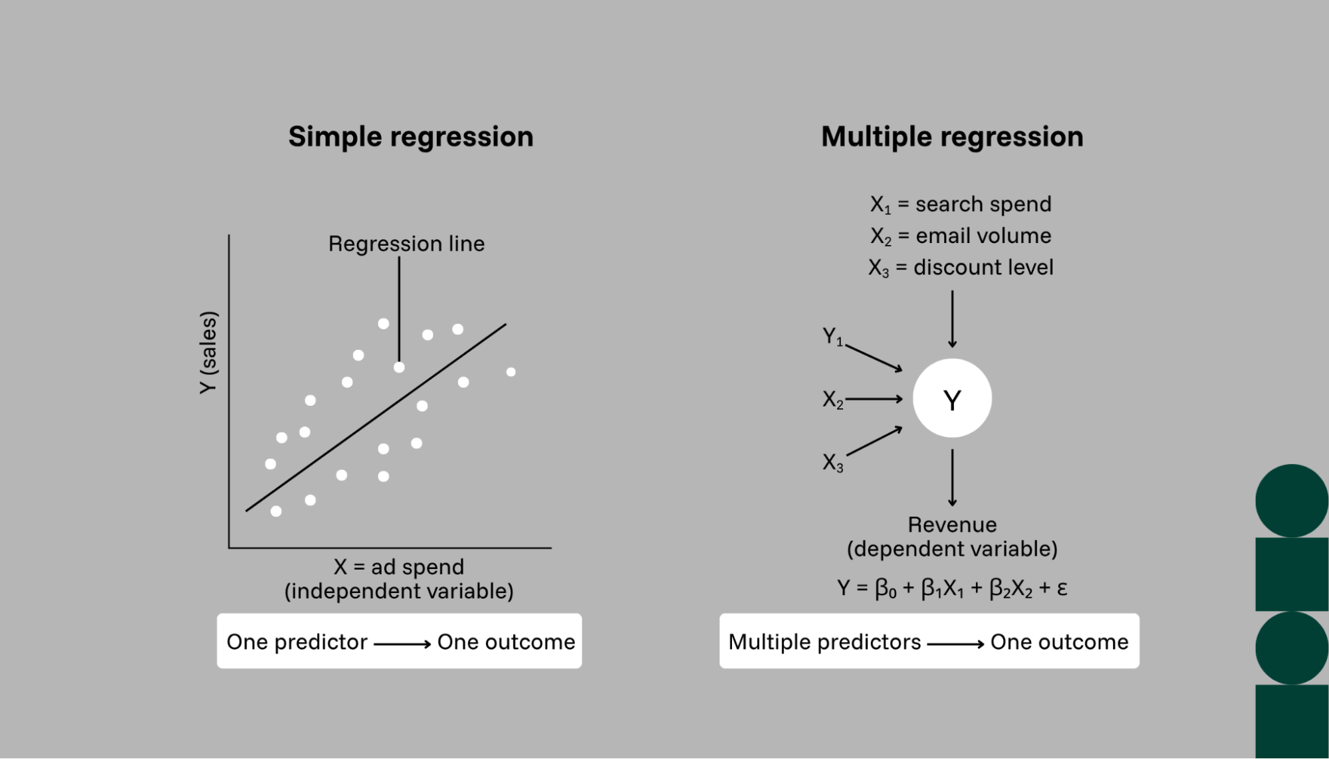
Multiple Linear Regression (Adding Complexity)
Concept: Predicting an outcome using multiple variables at once.
How it works: Instead of a 2D line, the math scales up to multiple dimensions (which humans can't easily visualize, but computers handle perfectly).
Real-World Use: Predicting a house price in Peshawar using size, location, and number of bedrooms.

Slide 4
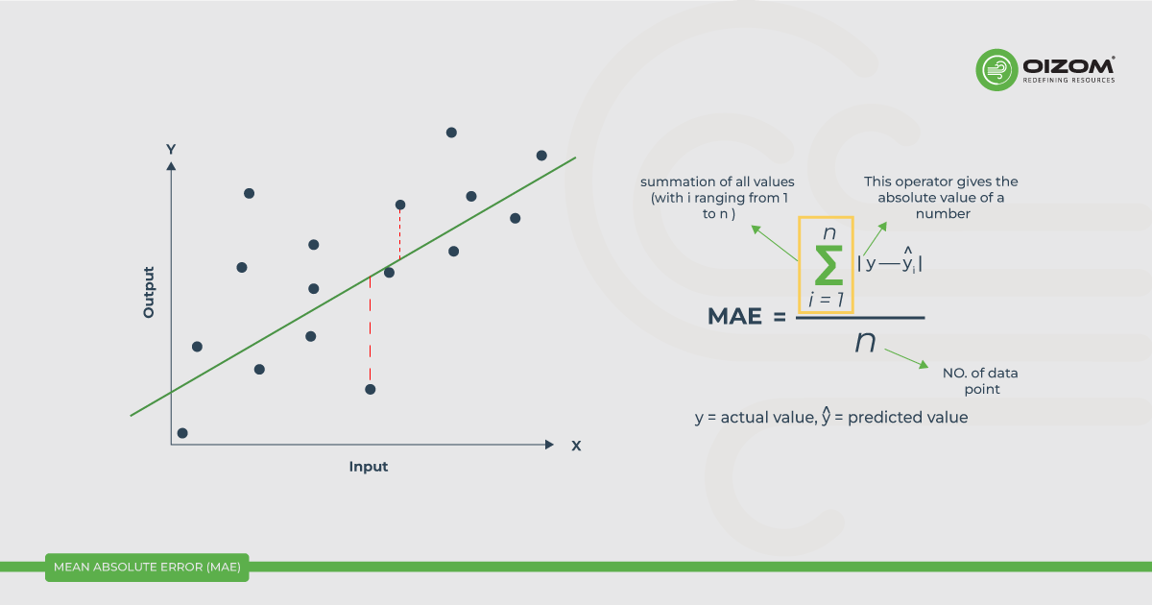
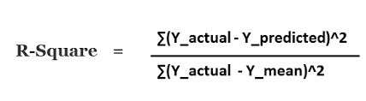
Evaluating the Model (Are We Right?)
The Problem: The AI will always give you a prediction, but how do we know exactly how wrong the predictions are in real numbers?
Metric 1: Mean Absolute Error (MAE): The average amount our prediction was off by. If predicting house prices, an MAE of "5" means we are off by 5 Lakhs on average.
Metric 2: R-Squared (R^2): A score from 0 to 1 (or 0% to 100%) showing how well our features explain the target. 0.90 is an excellent "A grade" model!

